Slide 1











COMMIT TO THE GIT
THE IMPACT OF WALKABILITY AND PUBLIC TRANSIT ON HEALTH
An analysis of the health of citizens in areas with high walkability and accessible public transit.

Slide 2

WHY?
Through our team discussions, we came to a realization. We had all experienced how difficult it can be to access necessities when transportation was limited.
Our goal was to explore how limited walkability or restricted access to food could impact a person's health.

Slide 3

Our
Hypotheses
NULL HYPOTHESIS
Census Tracts with a higher walkability score and increased access to public transit will have a lower rate of obesity and a longer life expectancy.
ALTERNATIVE HYPOTHESIS
Census Tracts with a higher walkability score and increased access to public transit will have a higher rate of obesity and a shorter life expectancy.
Commit to the Git | Final Project | Spring 2022

Slide 4







Data
Sources
Census Data
USDA Food Access Data
CDC Life Expectancy Data
Institute for Health Metrics and Evaluation Data
We used the American Community Survey data collected around the 2010 census to gather the census tract IDs and demographic information for each census tract in the United States.
This data set from the USDA gives each census tract a score based on how far citizens have to travel to access food. The census tracts are identified as "Low Income, Low Access" areas, otherwise known as Food Deserts.
This data set provides the average life expectancy of citizens in a given census tract.
This data set provides health information for citizens of each census tract. We used this to data to gather the rate of obesity in each census tract.
Commit to the Git | Final Project | Spring 2022

Slide 5




Narrowing
the Data
Health Data
City Data
Questions / Solution
There was so much health data to explore. Heart disease, obesity, cancer, mental illness, and more.
The census data set was huge; it included almost every demographic data point you could imagine.
What data most directly impacts our hypothesis?
What is our capacity as a team?
We determined that we should focus on heart disease, obesity, and life expectancy.
We determined that we should narrow the city data to income and transportation statistics.
Is our data still too large?
Will a model be able to process this data accurately and clearly?
We determined that the heart disease data was too vast and diverse.
We decided to remove some of the income data that would require a lot of scaling and encoding.
How do we maintain focus on our hypothesis?
This allowed us to narrow to our final data sets.
We finalized our data sets to measure obesity and life expectancy against transportation and food access data from each census tract.
Commit to the Git | Final Project | Spring 2022

Slide 6
We chose to use the Random Forest Regressor model for this project. This was perfect for our needs because it could predict continuous values without having to use PCA to cut down on the number of features.
This would allow us to use much more of the three features in our model as well as let us calculate the feature importance later.
We needed the feature importance fata in order to determine which aspects of infrastructure affected our targets the most.
Random Forest reduces overfitting and doesn't require feature normalization which helped us feel more confident about the accuracy of our model.
Choosing a Machine Learning Model
Commit to the Git | Final Project | Spring 2022

Slide 7


Clean the data in Jupyter Notebook.
Load the data into SQL. Join data in SQL.
Connect the model to the SQL database.
The
Modeling Process
Drop the columns describing location.
Drop the target columns (obesity, life expectancy).
Use sklearn train _ test _ split to determine targets and features.
Train the model and run a preliminary test.
Drop the % Low Income column to balance results.
Run final Random Forest Regressor models.
Commit to the Git | Final Project | Spring 2022

Slide 8
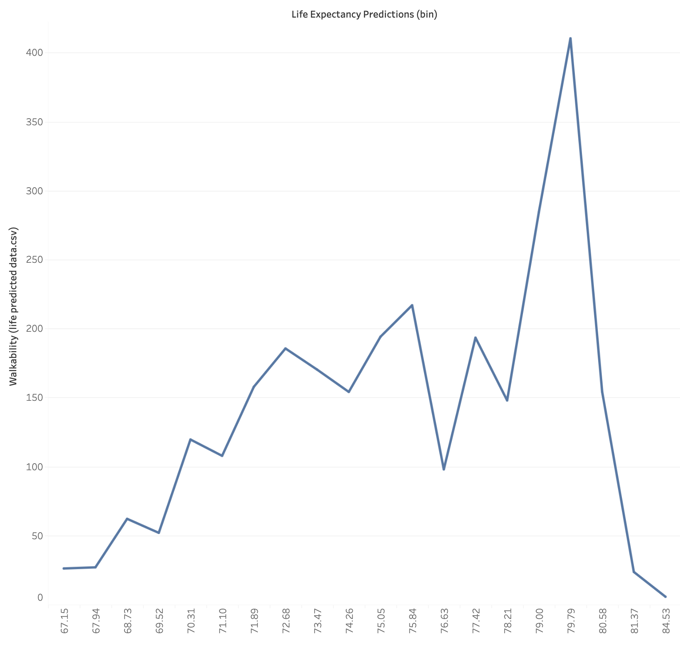
Feature Importance
Life Expectancy
This visualization illustrates describes the most important city features in determining life expectancy of an area's citizens.
Your Organization Name | SDG Progress Report 2025

Slide 9
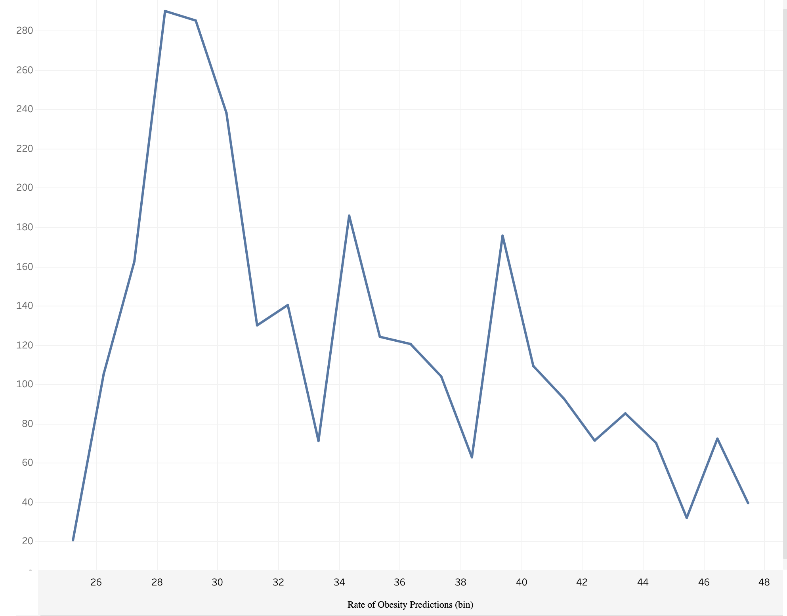
Feature Importance
Obesity
This visualization illustrates describes the most important city features in determining the rate of obesity in a particular area.
Your Organization Name | SDG Progress Report 2025

Slide 10
Tableau Dashboard
Obesity
Life Expectancy
Median Income by County
Poverty Rate by County
Population by County

Slide 11
CONCLUSION
Our Null Hypotheses was: Census Tracts with a higher walkability score and increased access to public transit will have a lower rate of obesity and a longer life expectancy.
In the end we did see a correlation between higher walkability scores and increased access to public transit to lower rate of obesity and a longe life expectancy.

Slide 12



Github
Github collaboration can be complicated. Files need to be clean and organized on the local computer.
Data Cleaning
Data Cleaning may involve a lot of extra research. Even though it seems solitary, it may require teamwork!
Challenges
Database Administration
Using SQL meant that our database administrator needed to run everything on the local computer.
Commit to the Git | Final Project | Spring 2022

Slide 13
Thank you for your interest in our project. Please check out our github for more detailed information about our process.
Commit to the Git
Rowena Quinn
Chris Swan
Kyle Kramer
Savannah McIntyre
Charles Bolton
Commit to the Git | Final Project | Spring 2022

Slide 14
Citations
Data Sources
INFRASTRUCTURE DATA
FOOD ACCESS DATA
LIFE EXPECTANCY DATA
OBESITY DATA
CENSUS TRACT DATA
Each resource is linked. Please feel free to click the links and explore our resources.
Coding Help and Research
Python: How To Convert SQL To DataFrame In Pandas
Approving a pull request with required reviews
Commit to the Git | Final Project | Spring 2022

